Slide 1
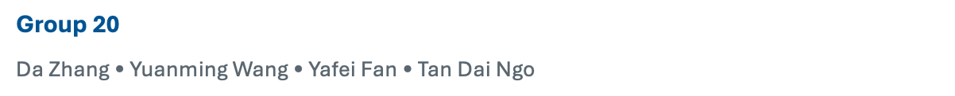
AI Customer IT Support Ticket Classification
Notes:
Hello everyone. We are Group 20, and our project is AI Customer IT Support Ticket Classification.

Slide 2
Agenda
Intro
EDA + Preprocessing
Model 1: TF_IDF + SVM
Model 2: BERT + NN
Model 3: TF_IDF + K-NN
Model Evaluation & Selection
Demo
Notes:
This is our agenda
(I will start with the motivation, the dataset, what we learned from EDA, and how we prepared the data for the models. After that, we will move into the three modeling approaches and then compare the final results.)

Slide 3
Project at a glance
From raw support tickets to three routing-related predictions.
Problem
Manual ticket triage is repetitive and inconsistent.
Goal
Use ticket text to predict labels that help route and prioritize requests.
Inputs
subject + body
Outputs
ticket type
priority
queue
Setup: supervised multi-class text classification
Notes:
First, the problem. A support team receives raw customer tickets, and someone has to decide what the ticket is about, how urgent it is, and which queue should handle it.
We model this as supervised multi-class text classification. The input is the combined subject and body, and the three outputs are ticket type, priority, and queue.
The goal is to take a raw customer support ticket and automatically predict useful routing labels, so the ticket can reach the right team more quickly.

Slide 4
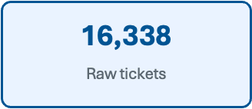
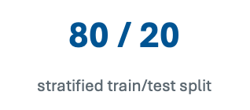
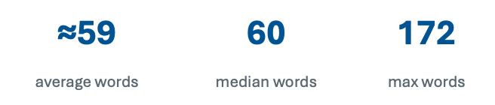
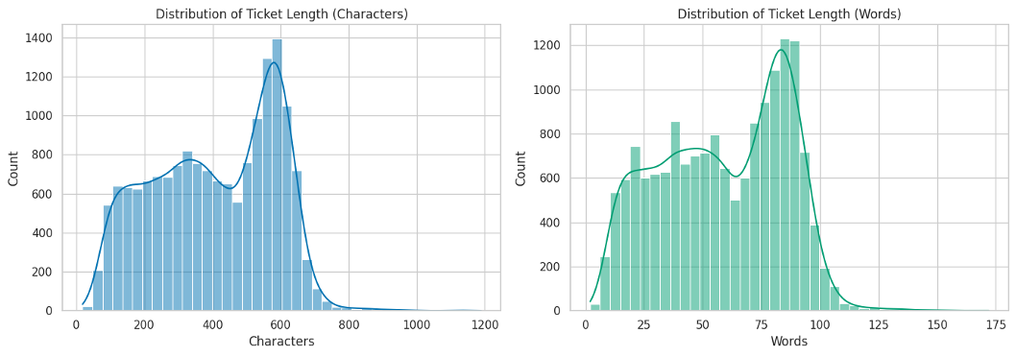
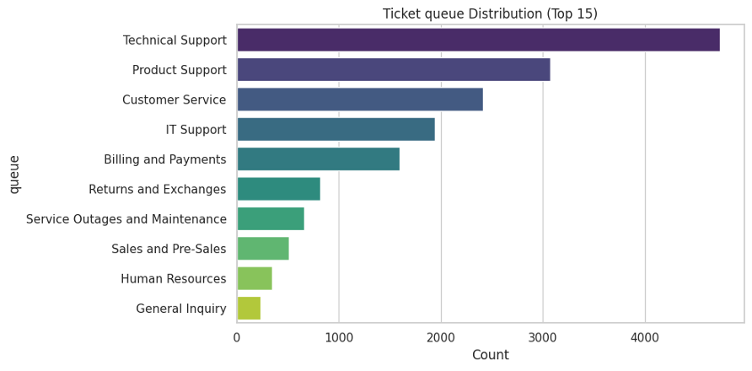
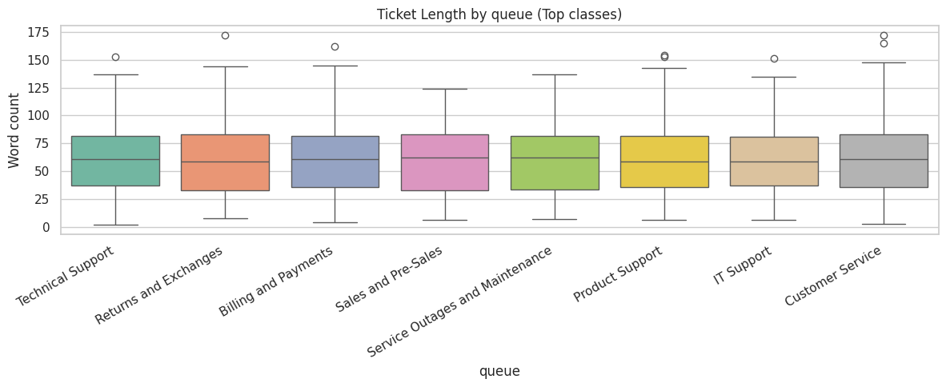
EDA
Most tickets are medium-length, but there is a visible spread. This supports using text features that can handle varied ticket detail.
Queue prediction is the hardest part: labels are imbalanced and several support queues use similar language.
Notes:
For the data, the average ticket has about 59 words, and the ticket length distribution is not perfectly uniform.
The main modeling difficulty is that the classes are not balanced, and support-related queues can overlap in wording. Some of the queue names are semantically close, such as Technical Support, IT Support

Slide 5
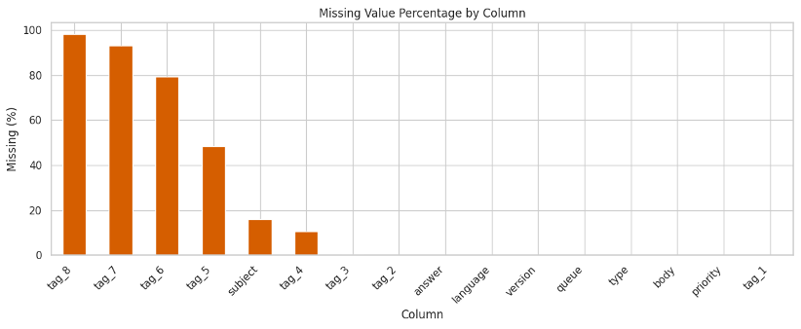
Preprocessing
Preprocessing pipeline:
→ combine subject + body
→ handle missing values (N/A)
→ stratified 80/20 split
→ vectorize for each model
Some metadata/tag fields are very sparse, so we focus on the reliable text fields: subject and body.
Why this matters
Same train/test structure for all model families
TF-IDF SVM/NN models use sparse word features
BERT + NN uses contextual text embeddings
Stratified split keeps label ratios stable
Notes:
The preprocessing pipeline is simple. We combine the subject and body, handle missing value, and then use a stratified 80-20 split. After that, different models use different representations, such as TF-IDF features or BERT embeddings.

Slide 6
TF-IDF + SVM
Notes:
Now, let’s look at our first modelling approach: combing TF-IDF for feature extraction with a Support Vector Machine classifier.

Slide 7
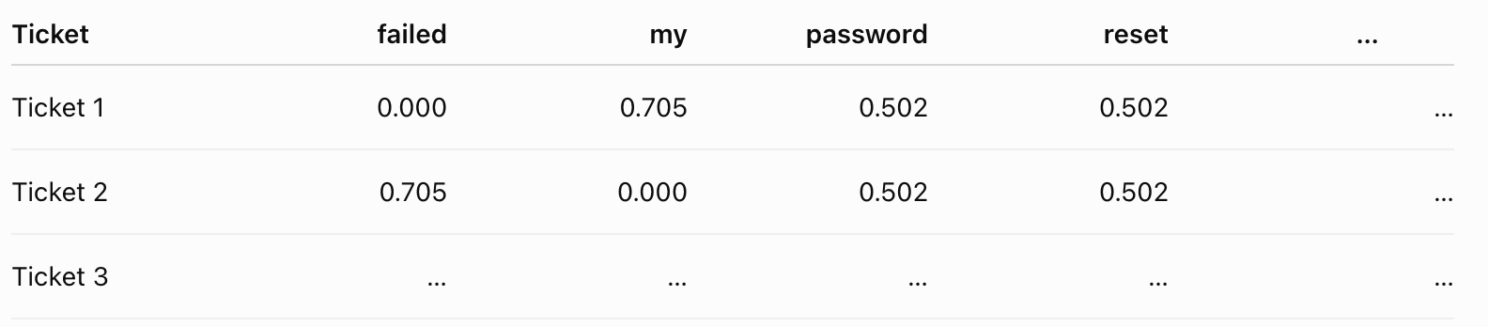


TF_IDF
Term Frequency (TF): measures how often a word appears in a document.
  Higher TF —> more importance of a word
Inverse Document Frequency (IDF): reduces the importance of words that appear in many documents, such as “the” or “and.”
  Higher DF —> Lower IDF —> less importance of a word
TF-IDF: combines the value of two measurements.
Words are important when they are frequent in one document but rare across corpus.
TF-IDF features visualization:
Notes:
To represent the text, we use TF-IDF.
TF stands for term frequency that measures how often a word appears in a specific document.
Inverse document frequency balances this by penalizing common words like “the” or “and”, which appear everywhere in the text.
By combining these two measures, we have the TF-IDF vectorization which creates a feature set for our SVM model.

Slide 8
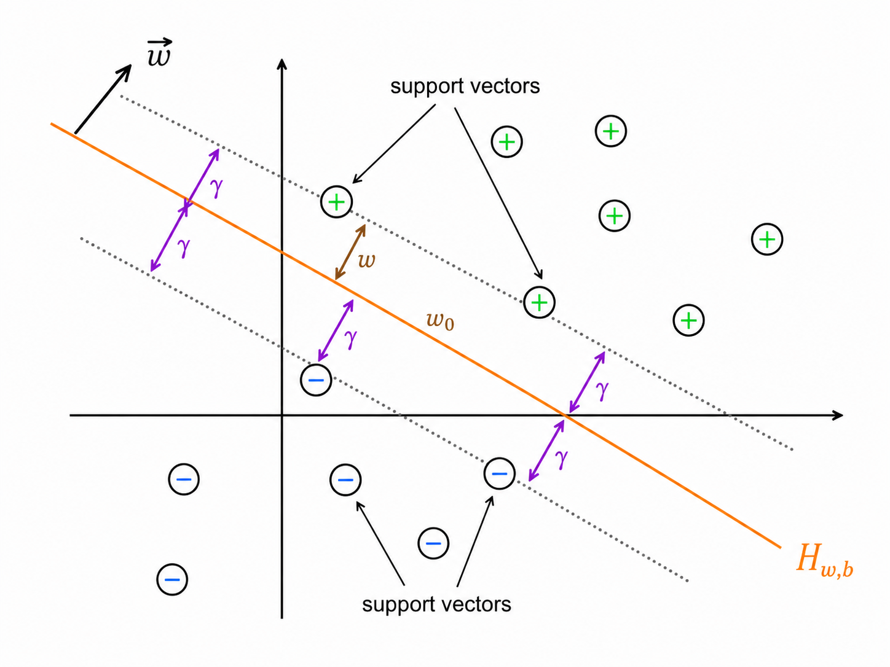


Support Vector Machine (SVM)
Margin (𝛾): the distance between the decision boundary 𝑯_{w,b} and the closest data points from each class (support vectors).
Linear SVM Objective: find the optimal decision boundary 𝑯_{w,b} that “best” separating separating the classes of data.
  “Best”: maximize the margin (to minimize the likelihood of error on unseen data )
Linear SVM Primal Formulation: optimized by Quadratic Programming (QP) Algo
Notes:
But what is a SVM?
If we define margin as the distance between the decision boundary to the closest data points form each class,
then the whole idea of linear SVM is just finding the optimal decision boundary with the maximum margin,
since this would minimize the likelihood of classification errors on unseen data.

Slide 9
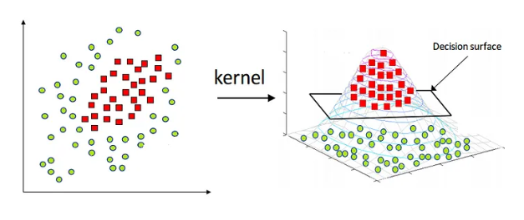
Kernel SVM
Q: What if the classes are not potentially linearly separable?
A: Use “kernel trick” to transform non-linearly separable data into a higher (Polynomial) or possibly infinite dimensional (RBF) space where it can be linearly separated by a straight decision boundary!
Notes:
But what if our data is not separated well by a linear classifier?
We’ve also tried a method called “kernel trick”, which allows us to project our data into a higher or even infinite-dimensional space,
where we can successfully separate the classes with a straight decision boundary.

Slide 10
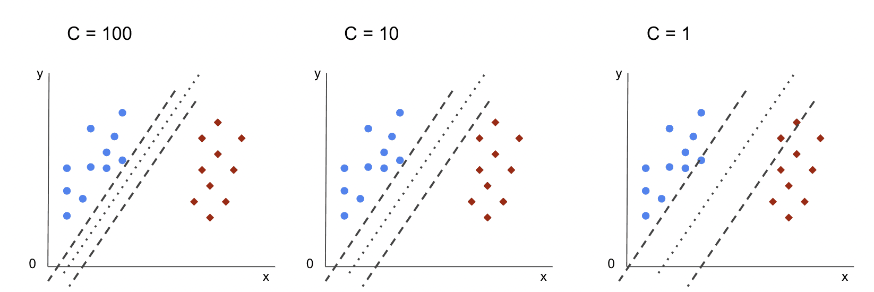
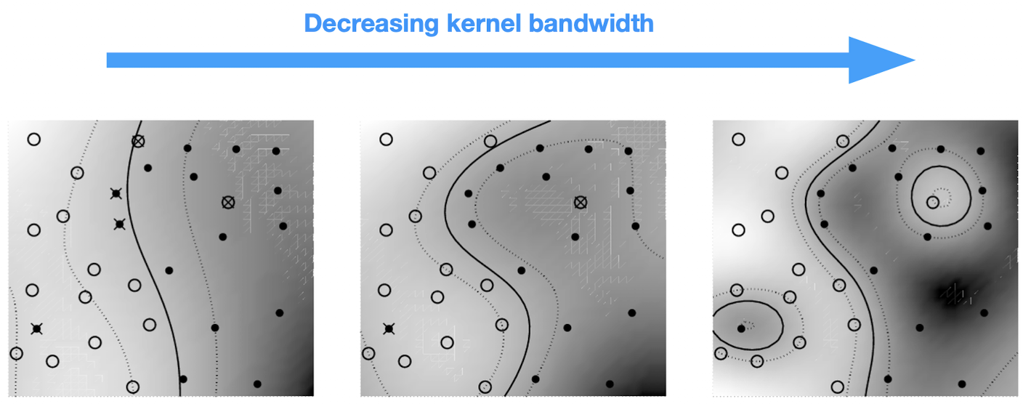
SVM Hyperparameter Tuning
Hyperparameters:
Kernel Degree: Linear/RBF
  (Introduced in the last slide)
Soft-Margin Regularization (C): trades off misclassification of training examples against simplicity of the decision boundary
  Small C —> higher regularization —> allow some misclassification
RBF Kernel Coefficient (gamma): defines how much a single training example influences
  Large Gamma —> closer-reaching influence —> more complex boundary
Notes:
To optimize performance, we tune key hyparameters.
The kernel Degree introduced in the last slide allows us to switch between Linear or RBF kernel.
Soft-margin Regularization is another hyperparameter that trades off training error against boundary simplicity.
Finally, for the RBF kernel SVM, we adjust ‘gamma’ to control the influence of individual training examples on the model’s complexity.

Slide 11
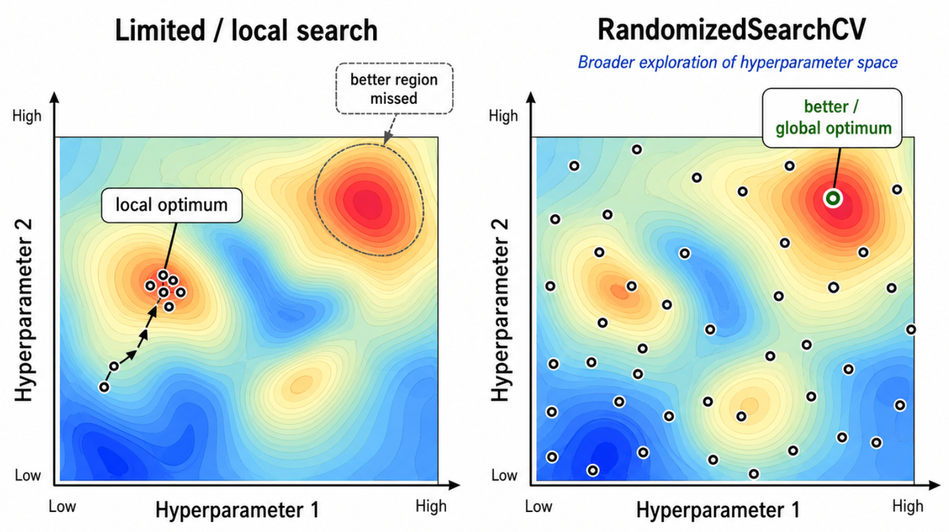
SVM Hyperparameter Tuning - RandomSearch
Search & Tuning Strategy:
RandomizedSearchCV()
  K-fold Cross Validation
  Randomized Search
Notes:
For this tuning process, we utilize RandomizedSearchCV which combines the idea of randomized search with k-fold Cross Validation.

Slide 12
BERT + NN

Slide 13
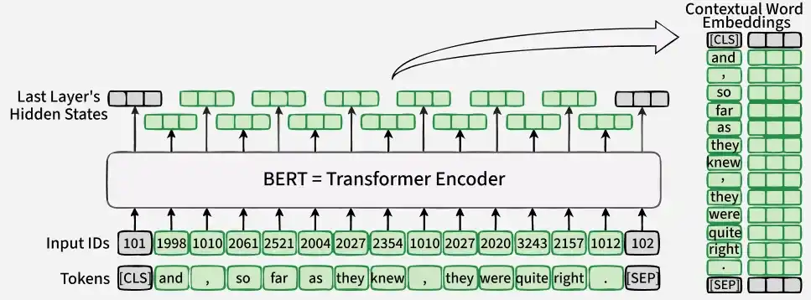
BERT
(Bidirectional Encoder Representations from Transformers)
Converting raw texts into numeric vectors (“embeddings”) to capture semantic meaning
Embedding process:
  Tokenize ticket texts into batches (size 32, max length 128)
  Get token-level hidden states from BERT after learning each token context
  Collapse to one vector using mean for all tokens, avoid padded empty words
  Output feature vectors as input for NN model training instead of the original ticket texts
Notes:
We used BERT to convert raw ticket text into numeric vectors to capture semantic meaning so a neural network can actually process it.
We tokenize the ticket text into batches of 32 with a max length of 128, then run it through BERT to get a contextual vector for every individual token shaped by the surrounding sentence.
Since tickets vary in length, we collapse all those token vectors into a single fixed-size vector per ticket by averaging them.

Slide 14
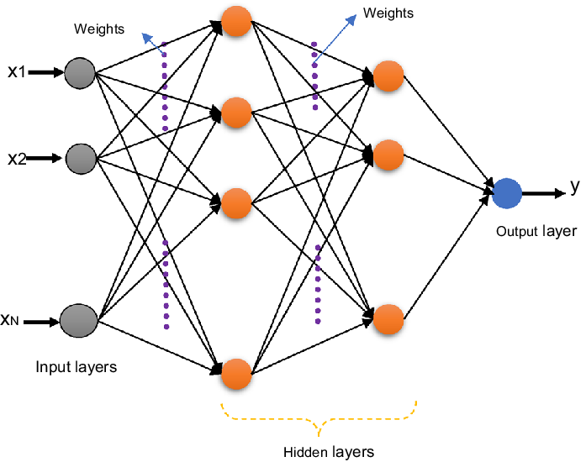
Multi-Layer Perceptron (Neural Network)
feedforward, each neuron applying weights + bias + nonlinear activation (ReLU/tanh), trained via backpropagation
Input: BERT ticket embeddings
Tuned hyperparameters (by GA): hidden_layer_sizes, activation, alpha (L2 regularization), learning_rate_init
Output: ticket type/priority/queue
Select model with the lowest CV error based on 3-Fold StratifiedKFold CV
Notes:
In our project, we used Multi-Layer Perceptron as our a feedforward neural network model that takes the BERT ticket embedding as input, passes it through hidden layers where each neuron applies weights, a bias, and a nonlinear activation, and learns via backpropagation.
The key hyperparameters are the hidden layer sizes, activation function, L2 regularization, and learning rate.

Slide 15
NN Hyperparameter Tuning - Genetic Algorithm
Search & Tuning Strategy:
Hyperparameter search for predicting ticket type, priority, and queue
Individual genome: hidden_layer_sizes, activation, alpha (L2 regularization), learning_rate_init
Fitness function: mean cross-validation error of a specific NN model configuration using 3-fold StratifiedKFold CV
Evolution (population = 8, generations = 5)
  Seed random population
  Evaluate fitness of every individual
  Elitism
  Tournament selection (k=3) for parents
  Uniform crossover (coin flip) + mutation (p=0.3)
  Repeat for all generations and select the best genome
Notes:
The genetic algorithm was used to search for the best hyperparameters of the neural network model separately for predicting ticket type, priority, and queue with the fitness being measured through 3-fold stratified cross-validation.
Starting from a random population of 8, each generation evaluates every individual's fitness, keeps the best one unchanged, and selects parents via tournament selection to breed children through uniform crossover and mutation.
This repeats for 5 generations, ultimately selecting the best-performing genome for each prediction task.

Slide 16
TF-IDF + K-NN

Slide 17
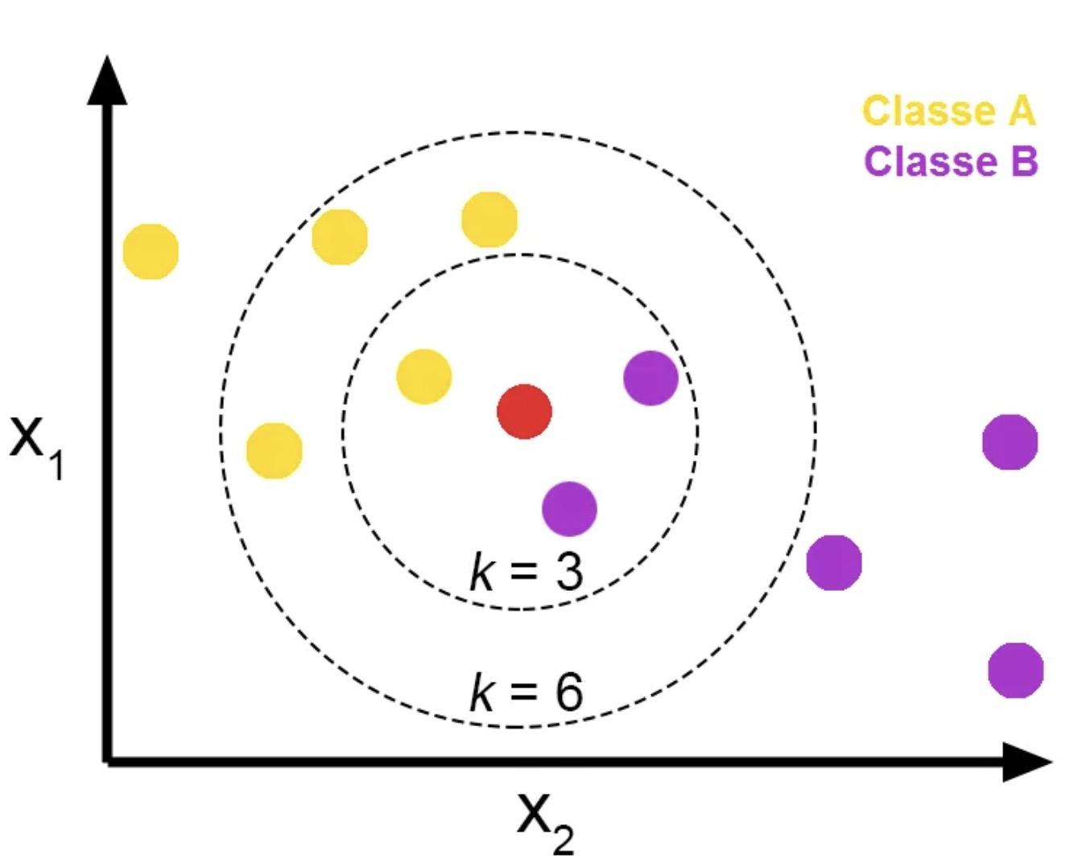
k-Nearest Neighbors (Weighted kNN)
Idea: Makes predictions based on the most similar training examples.
Prediction: For a new sample, the model finds the k nearest neighbors in the training set.
Hyperparameter: k (number of the most similar neighbors)
The final label is decided by distance-weighted vote.
kNN does not learn a complex global model; it mainly relies on similarity between cases.
Notes:
The third method we use is kNN.
For each new input, the model finds the k nearest neighbors in the training set, and then uses their labels to make the final prediction.
In our project, we use distance-weighted voting, so closer neighbors have more influence.

Slide 18
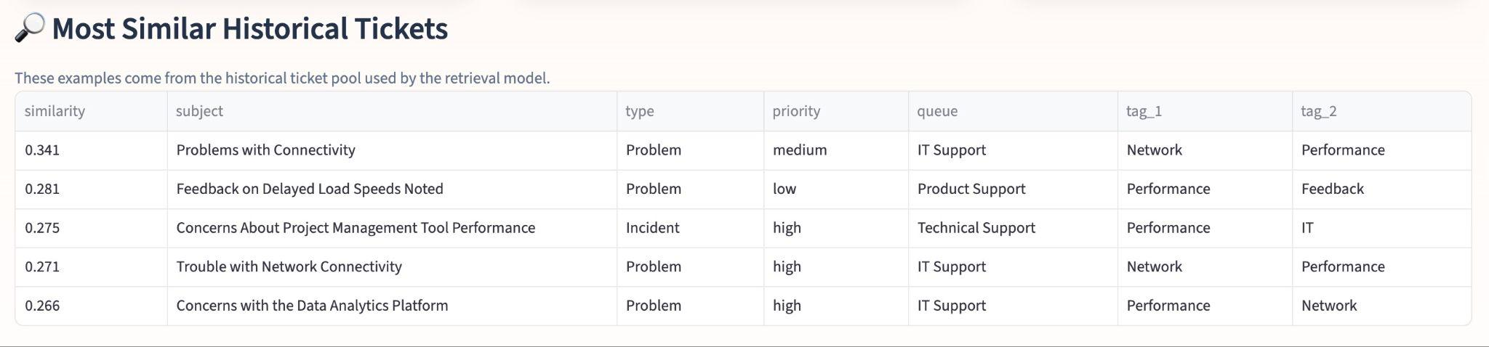
kNN for Ticket Triage
Each ticket is converted into a TF-IDF vector from its text.
Using cosine similarity to measure how similar two tickets are.
For a new ticket, the model retrieves the most similar historical tickets.
This works well because many support tickets contain recurring issue patterns.
Notes:
In our project, we firstly convert each ticket into a TF-IDF vector.
Then we use cosine similarity to compare.

Slide 19
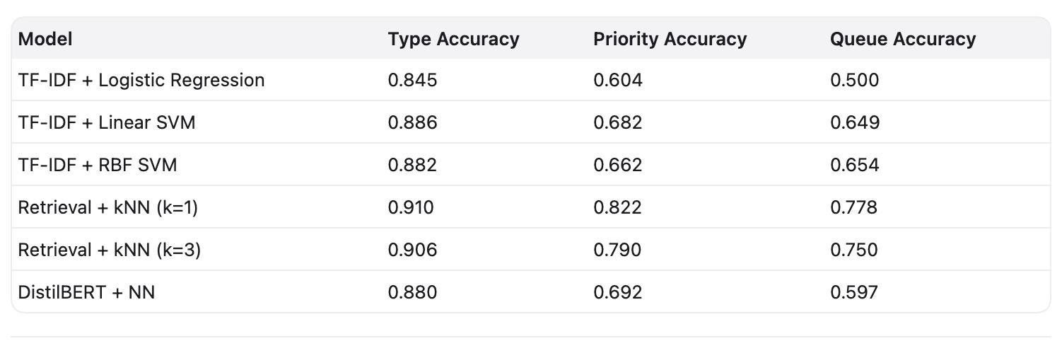
Model Performance Comparison
Accuracy of Each Model Across the Three Tasks:
Notes:
This table compares the performance of all our models, the logistic regression model is used as the baseline.
Since our dataset is not balanced, accuracy alone is not enough for evaluating the performance, we need look into other metrics such as precision, f1, recall.
Looking at all these metrics together, we found kNN is the best overall model.

Slide 20
TF-IDF + weighted kNN
  Works best on our dataset because many tickets are very similar to past cases
  TF-IDF gives text vectors, and cosine similarity is a natural way to compare them
  In our project which is a sparse search space, nearest-neighbor matching can capture repeated ticket patterns directly
TF-IDF + Linear SVM
  Strong classical baseline for high-dimensional sparse text
  Learns a stable global decision boundary
  Performs well, but may miss some local case-level similarity
TF-IDF + RBF Kernel SVM
  Can model more complex boundaries
  Did not clearly outperform Linear SVM in our setting
  Suggests the TF-IDF space may already be well separated by a linear model
BERT + NN
  Captures contextual meaning better than pure bag-of-words features
  Helps on semantic understanding, especially for ticket type
  But on this dataset, repeated ticket patterns make retrieval methods even more effective
Notes:
Because of the dataset size and we are dealing with nl, the search space is very sparse.
In this case, kNN works the best because it can directly rely on the nearest historical cases.
Since many support tickets are very similar to previous ones, this matching-based method is very effective.
In the meantime, other models such as SVM or nn models try to learn broader patterns from the data, and that advantage may not be fully visible here.
But in a larger and more diverse real-world environment, they will have more advantage.

Slide 21
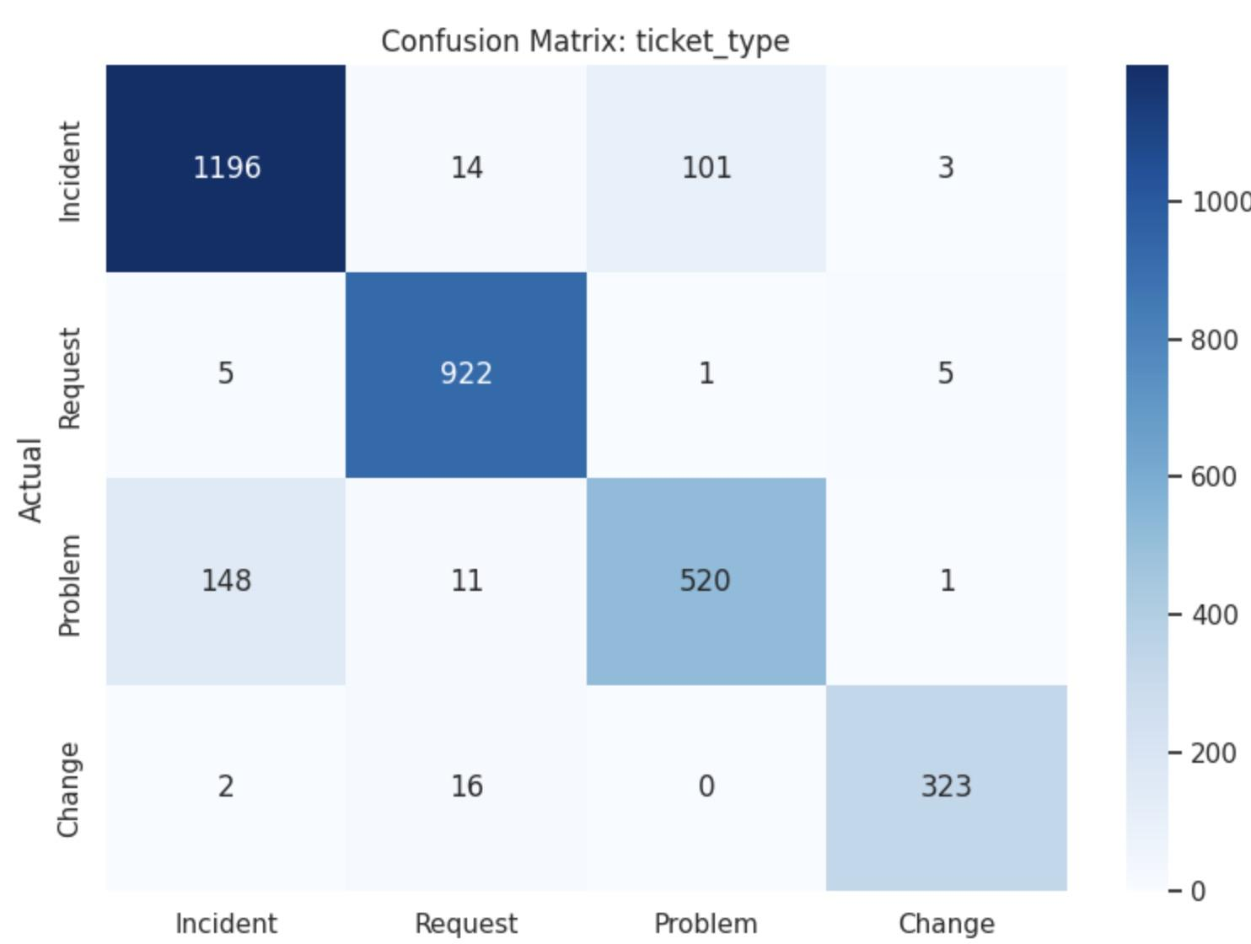
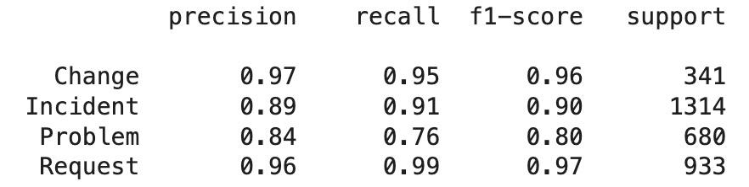
Ticket type analysis
Best task overall
Accuracy 0.91, weighted F1 0.90
Strong on Change and Request
Main confusion: Problem vs Incident
Notes:
For ticket type, the kNN model performs very well, with around 91 percent accuracy and a weighted F1.
Most elements in the confusion matrix lie on the diagonal, so most tickets are classified correctly.

Slide 22
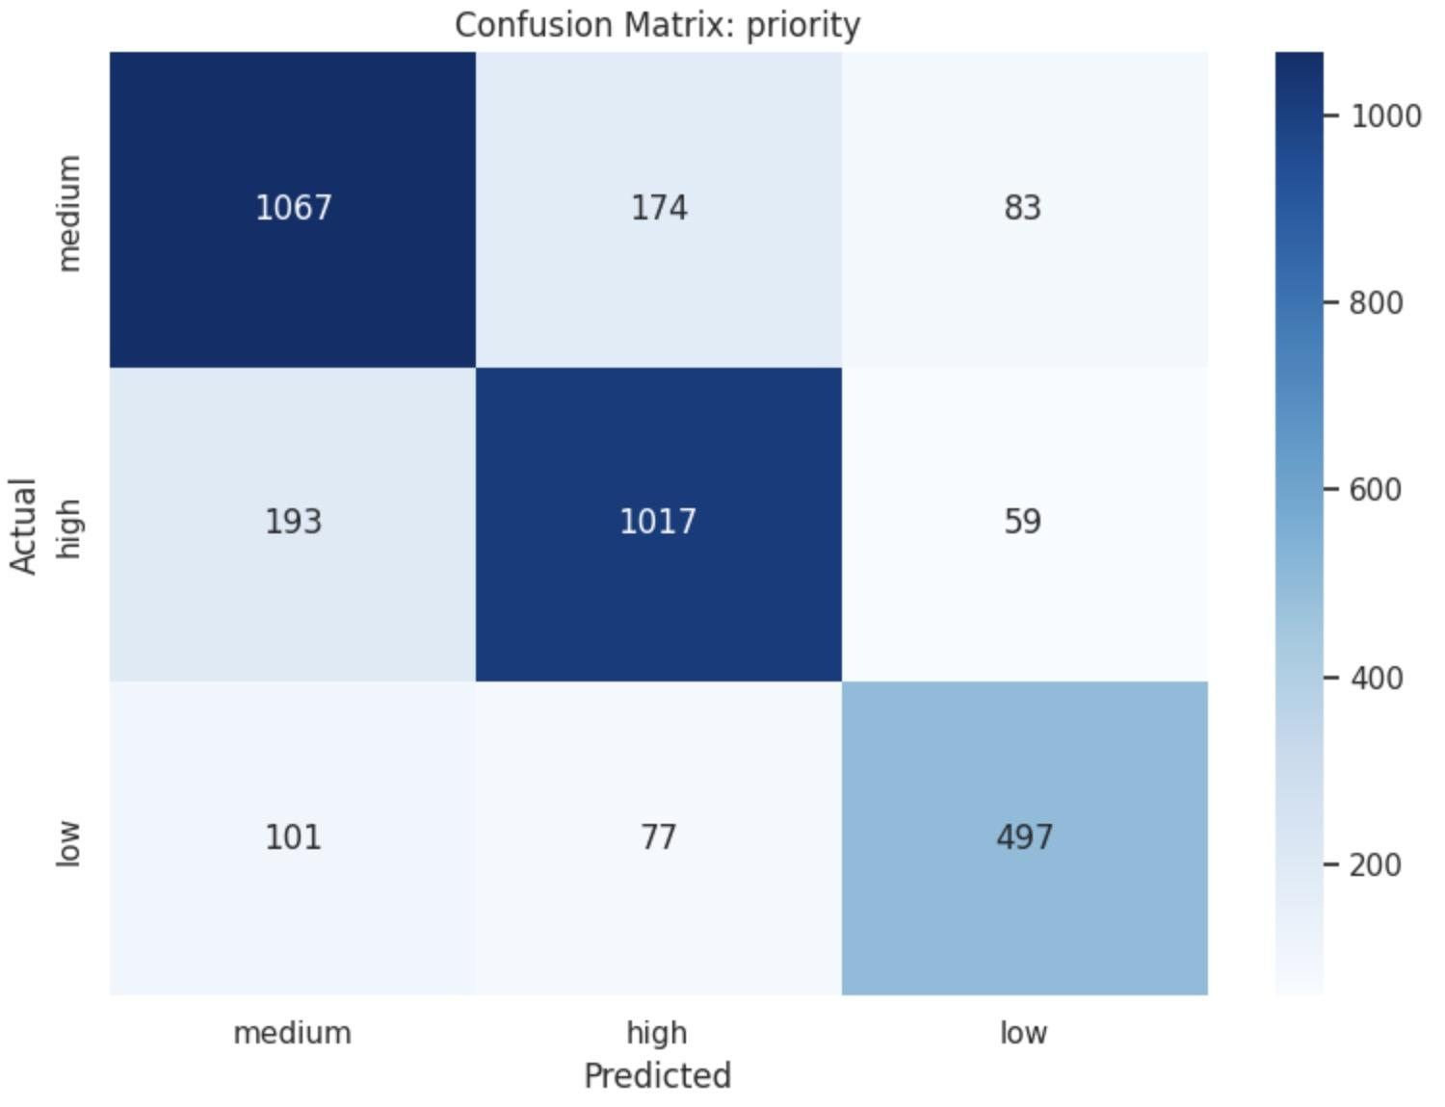
Priority type analysis
Accuracy = 0.79, Weighted F1 = 0.79
Priority prediction is harder because urgency is often implied rather than explicitly stated
For the high class,:
  non-high predicted as high: 251
  high predicted as non-high: 252
Over-predicting high is usually more tolerable, because it mainly increases workload
Under-predicting high is more risky, especially high -> low (59 cases), since urgent tickets may be delayed
Notes:
Priority prediction is harder than ticket type, the urgency is often not directly written in the text.
The model gets around 79 percent accuracy and weighted F1.
For high priority, most urgent tickets are recognized correctly.
Some medium or low tickets are predicted as high, this is more acceptable because it only increases workload.
The more risky mistake is when a true high-priority ticket predicted as medium or low.
Especially, high predicted as low is the most dangerous error, because an urgent issue may be delayed.
but this dangerous situations are not very frequent (only 59 cases).

Slide 23
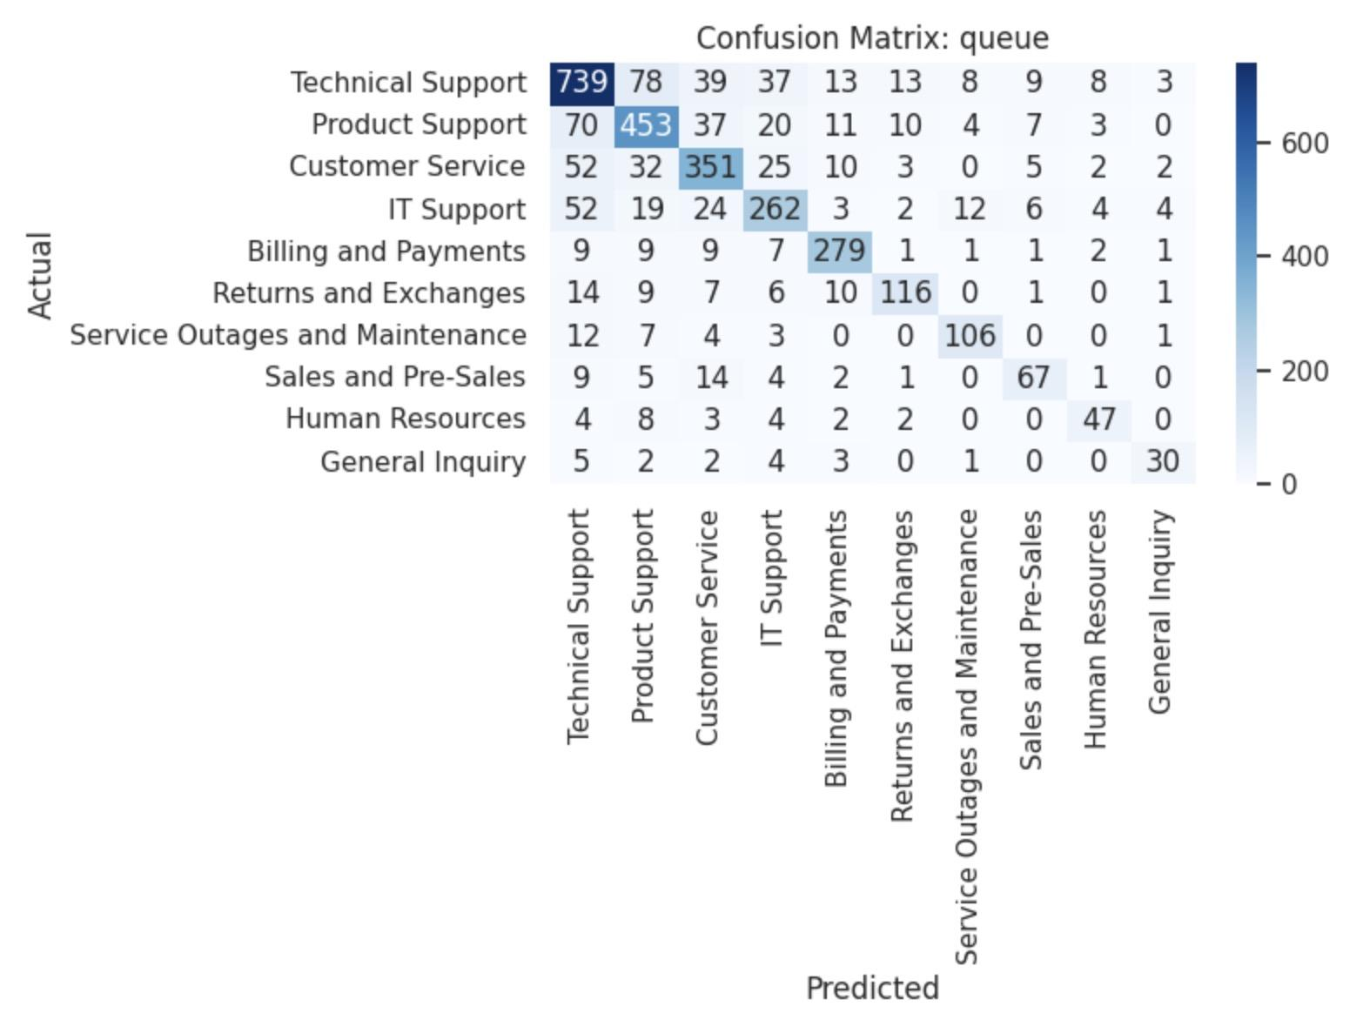
Queue type analysis
Accuracy = 0.75
Weighted F1 = 0.75
Queue prediction is the hardest task
There are 10 classes, making this a much finer-grained problem
Strong performance despite large class space and overlapping responsibilities
Most confusion happens among similar technical/service-related queues
Queue labeling is partly subjective, so some errors are expected
Notes:
Queue prediction is the hardest task in our project.
It has 10 classes, and some queues are similar to each other.
Even so, our model still gets 75 percent accuracy and weighted F1, which is already a pretty strong result.
Most of the mistakes is between similar queues, such as Technical Support, Product Support, and IT Support.
Also, queue routing is subjective even for human agents, so this level of performance is still very encouraging.

Slide 24
DEMO
Notes:
Here, we make a small demo for our project.

Slide 25


Thank you for your attention!
Q&A

